Slide 1
Name: Jukanti Pooja
Module: Fund’s SQL
Batch : 12pm-2pm
Batch Faculty: Nidhi Bhatt
Topic: Market Management System

Slide 2
Introduction
The MARKET MANAGEMENT SYSTEM provide the facilities and store the customer information in the collective report format. This entire project related data are stored in the separate file.
Using this files, the information about various customer bill and purchase order,customer information, employee information, product information in the database.
This data is used for generating report.

Slide 3
Tables in DataBase
Customer_Info
OrderTable
Product
Employee_Info
Bill

Slide 4
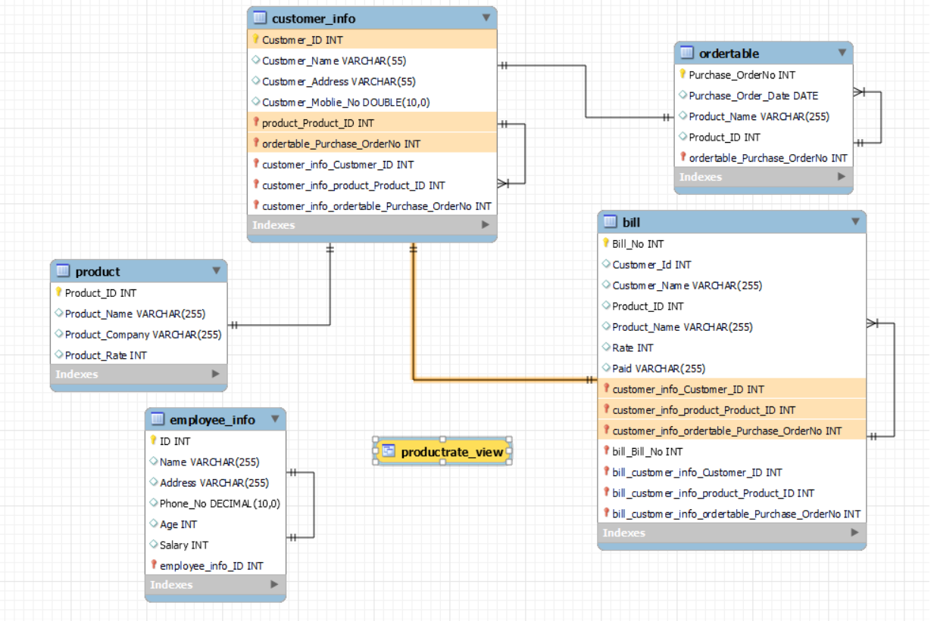
ER Diagram.

Slide 5
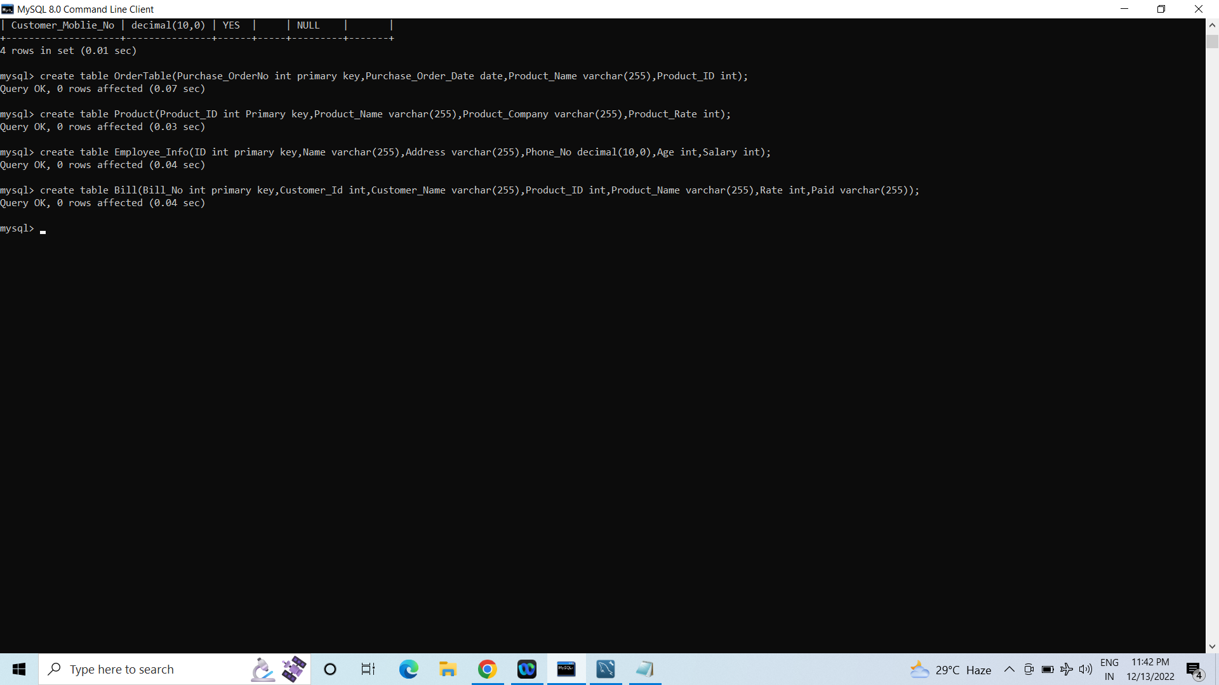
To Create a Table.

Slide 6
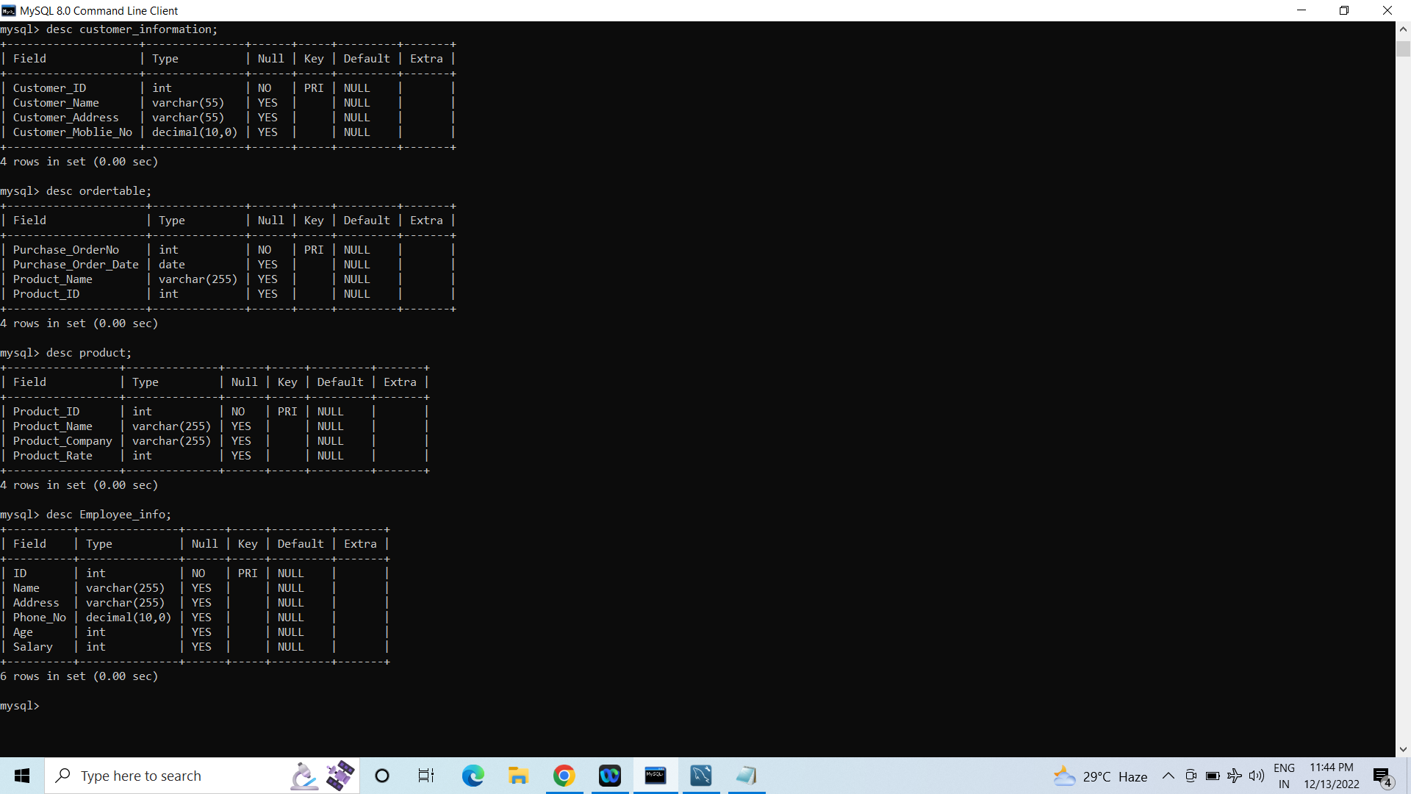
To Show the Structure of Table.

Slide 7
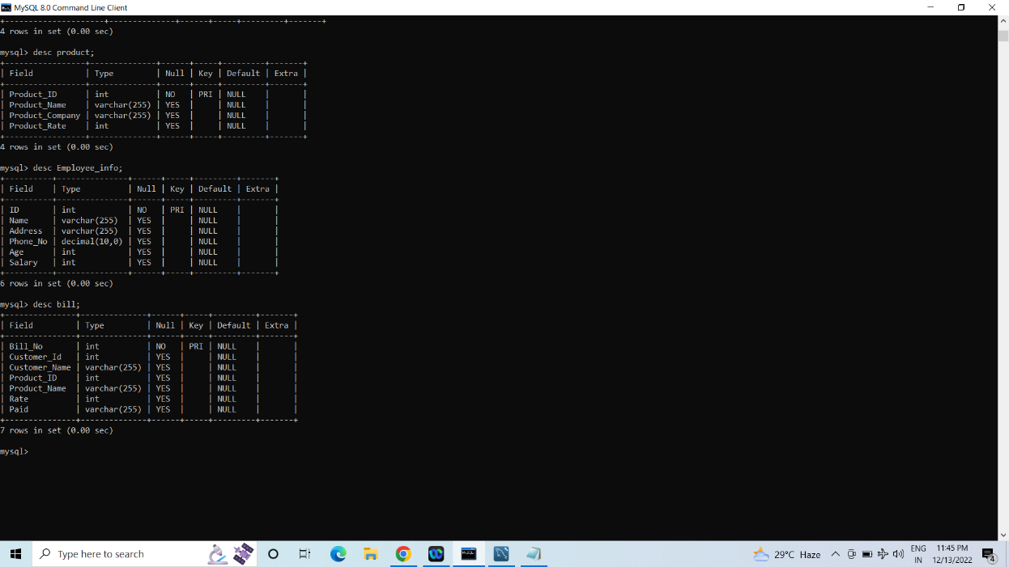
To Show the Structure of Table.

Slide 8
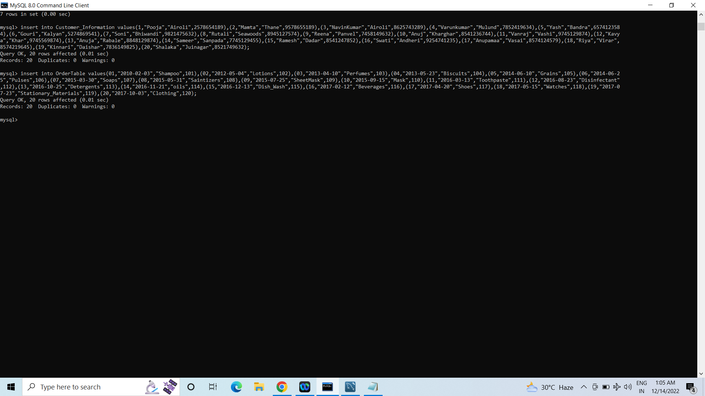
To Insert Data in Table.

Slide 9
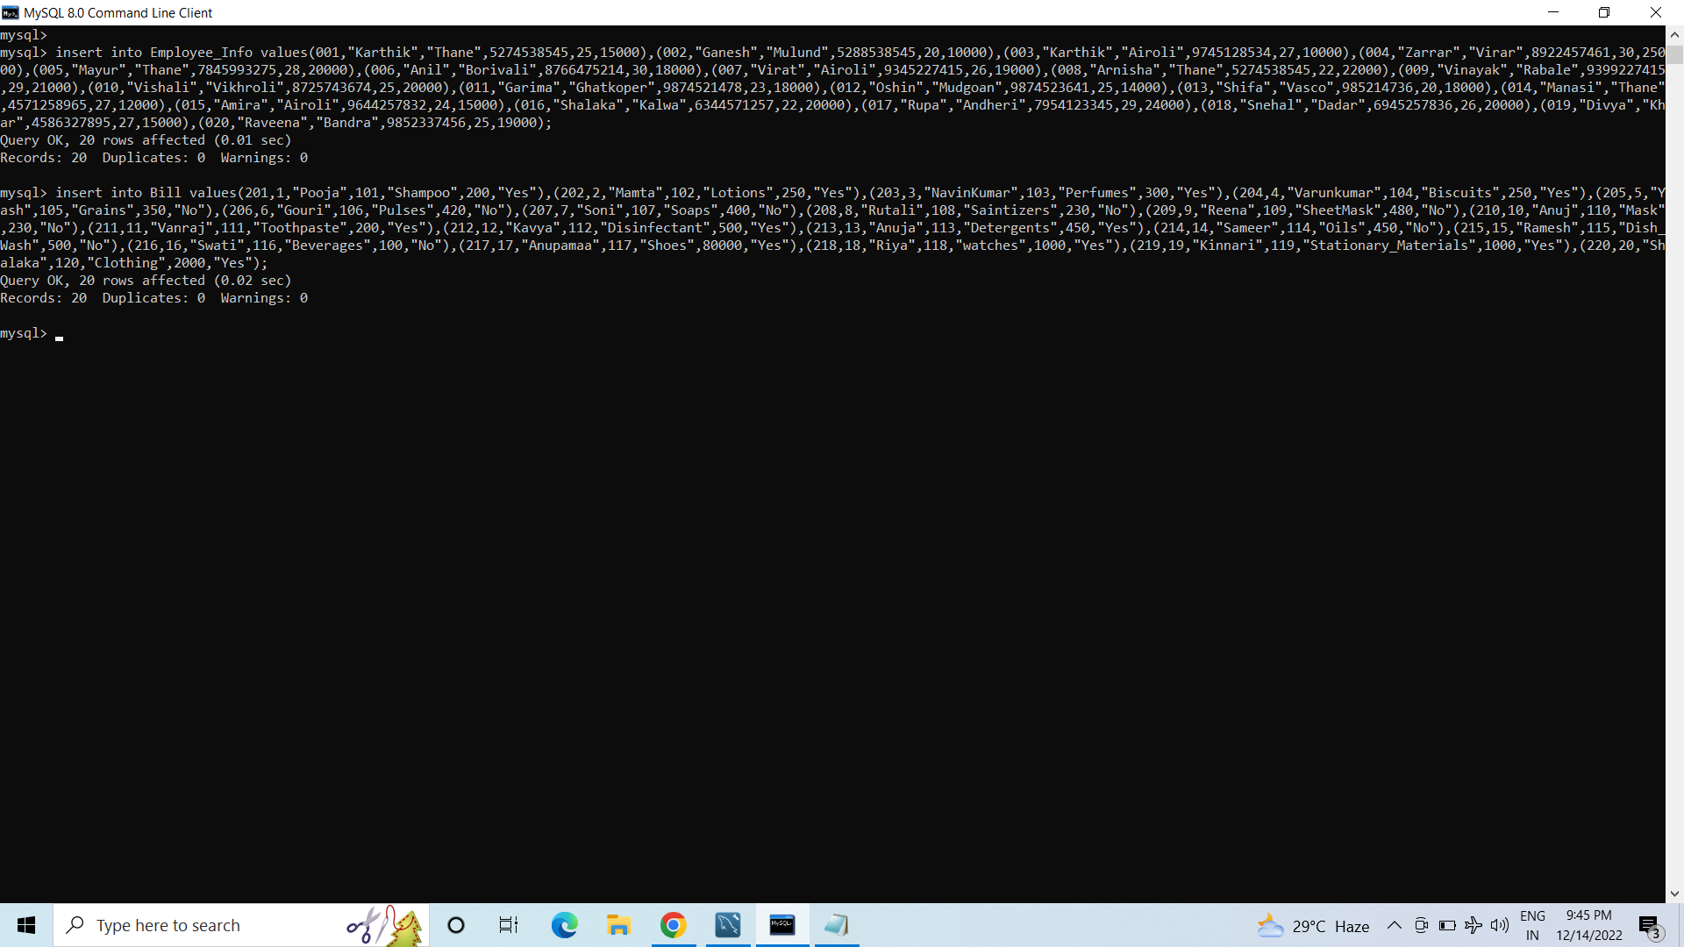
To Insert Data in Table.

Slide 10
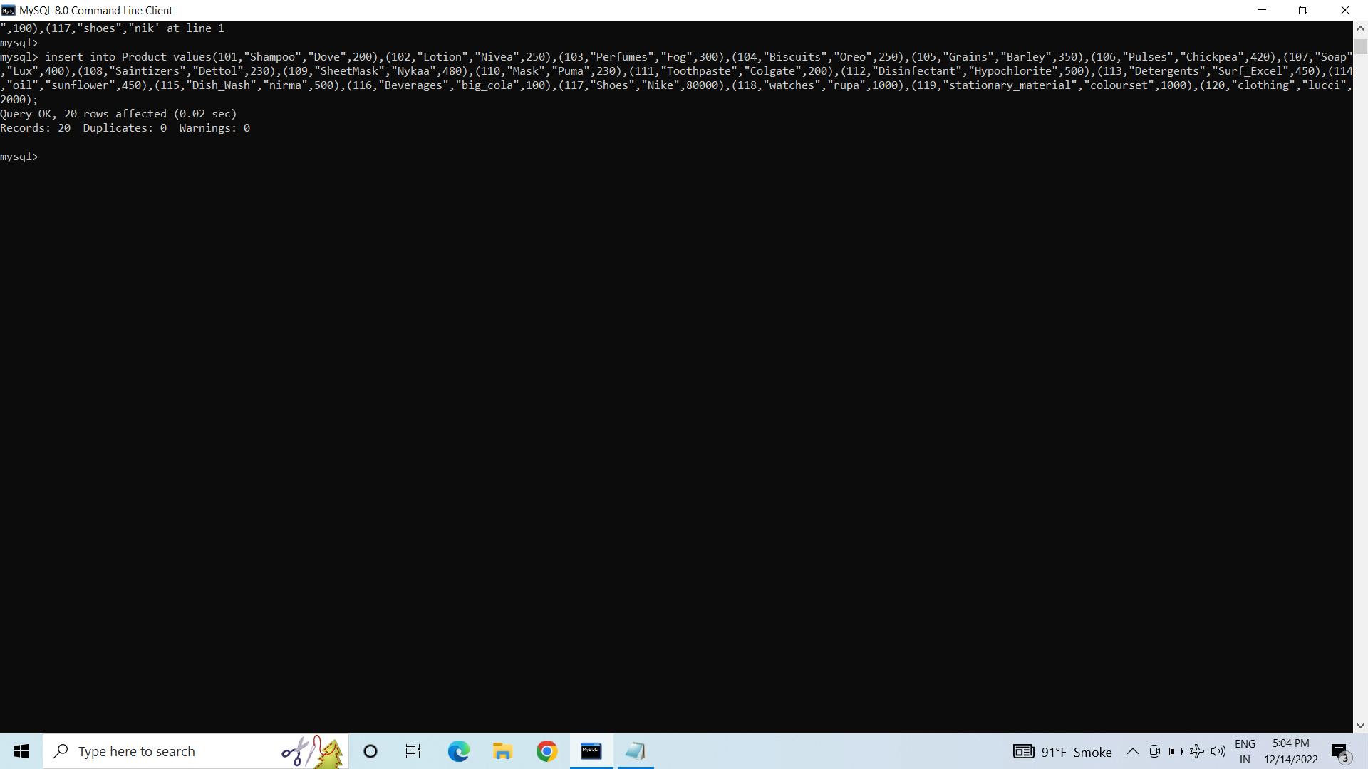
To Insert Data in Table.

Slide 11
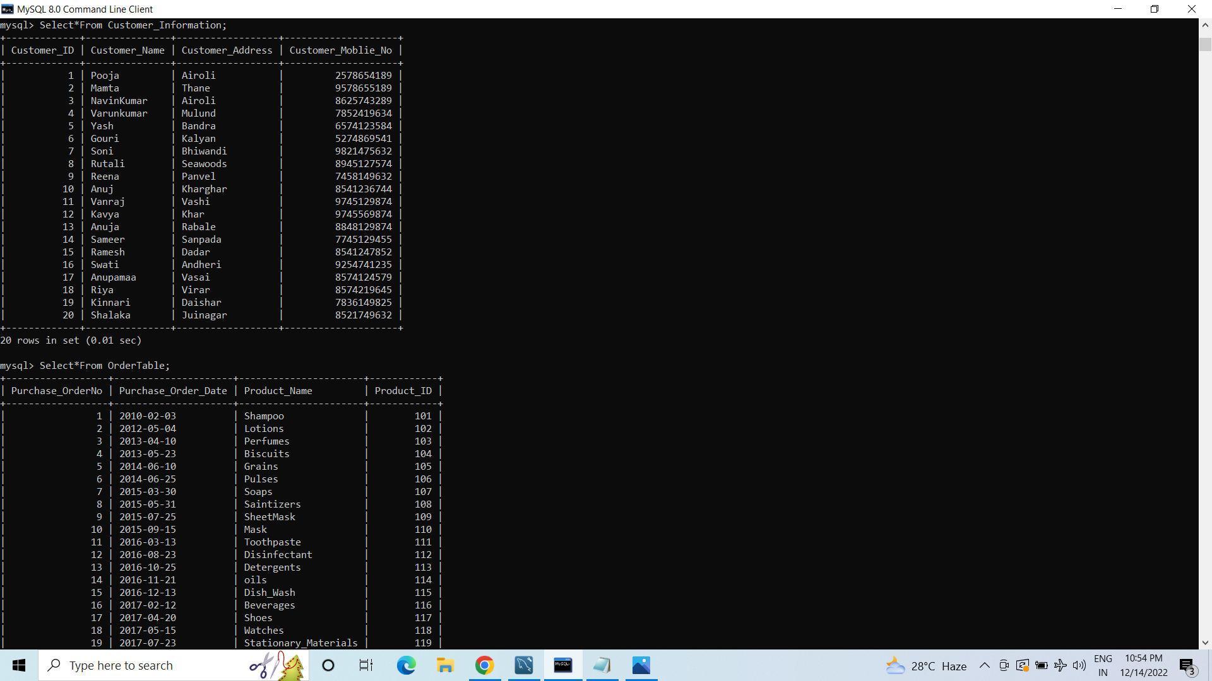
To Read the Data from the Table.

Slide 12
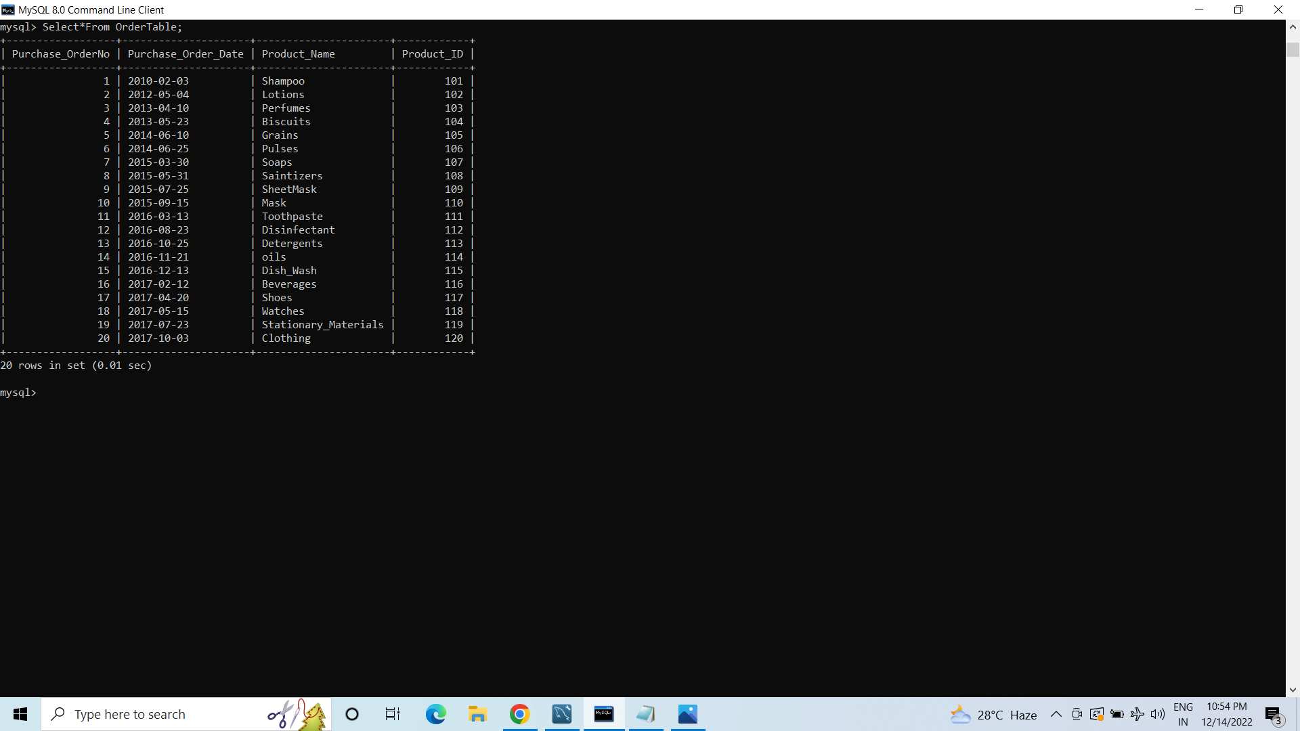
To Read the Data from the Table.

Slide 13
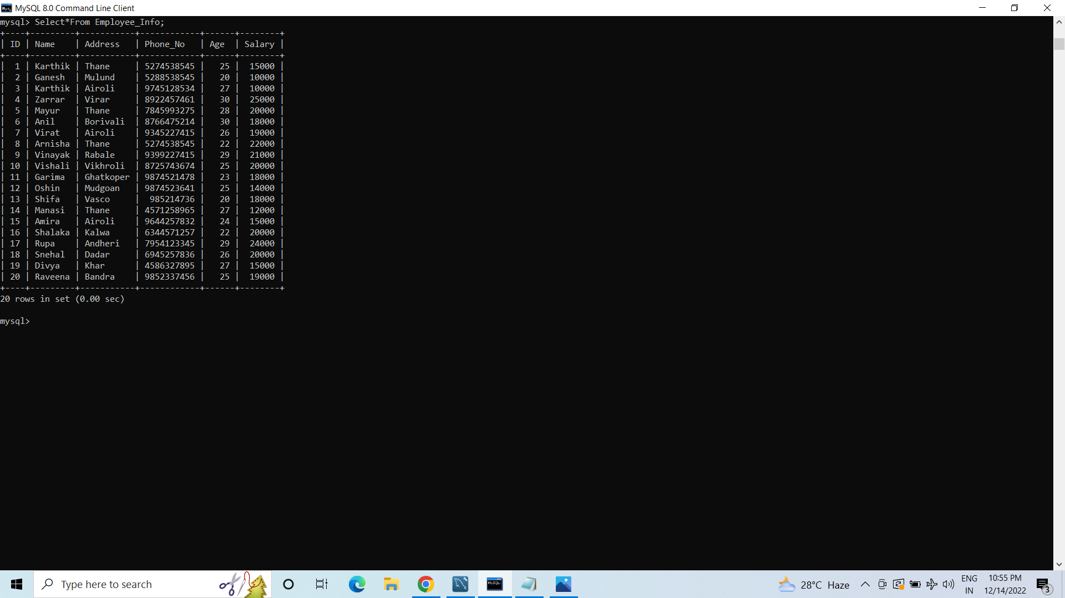
To Read the Data from the Table.

Slide 14
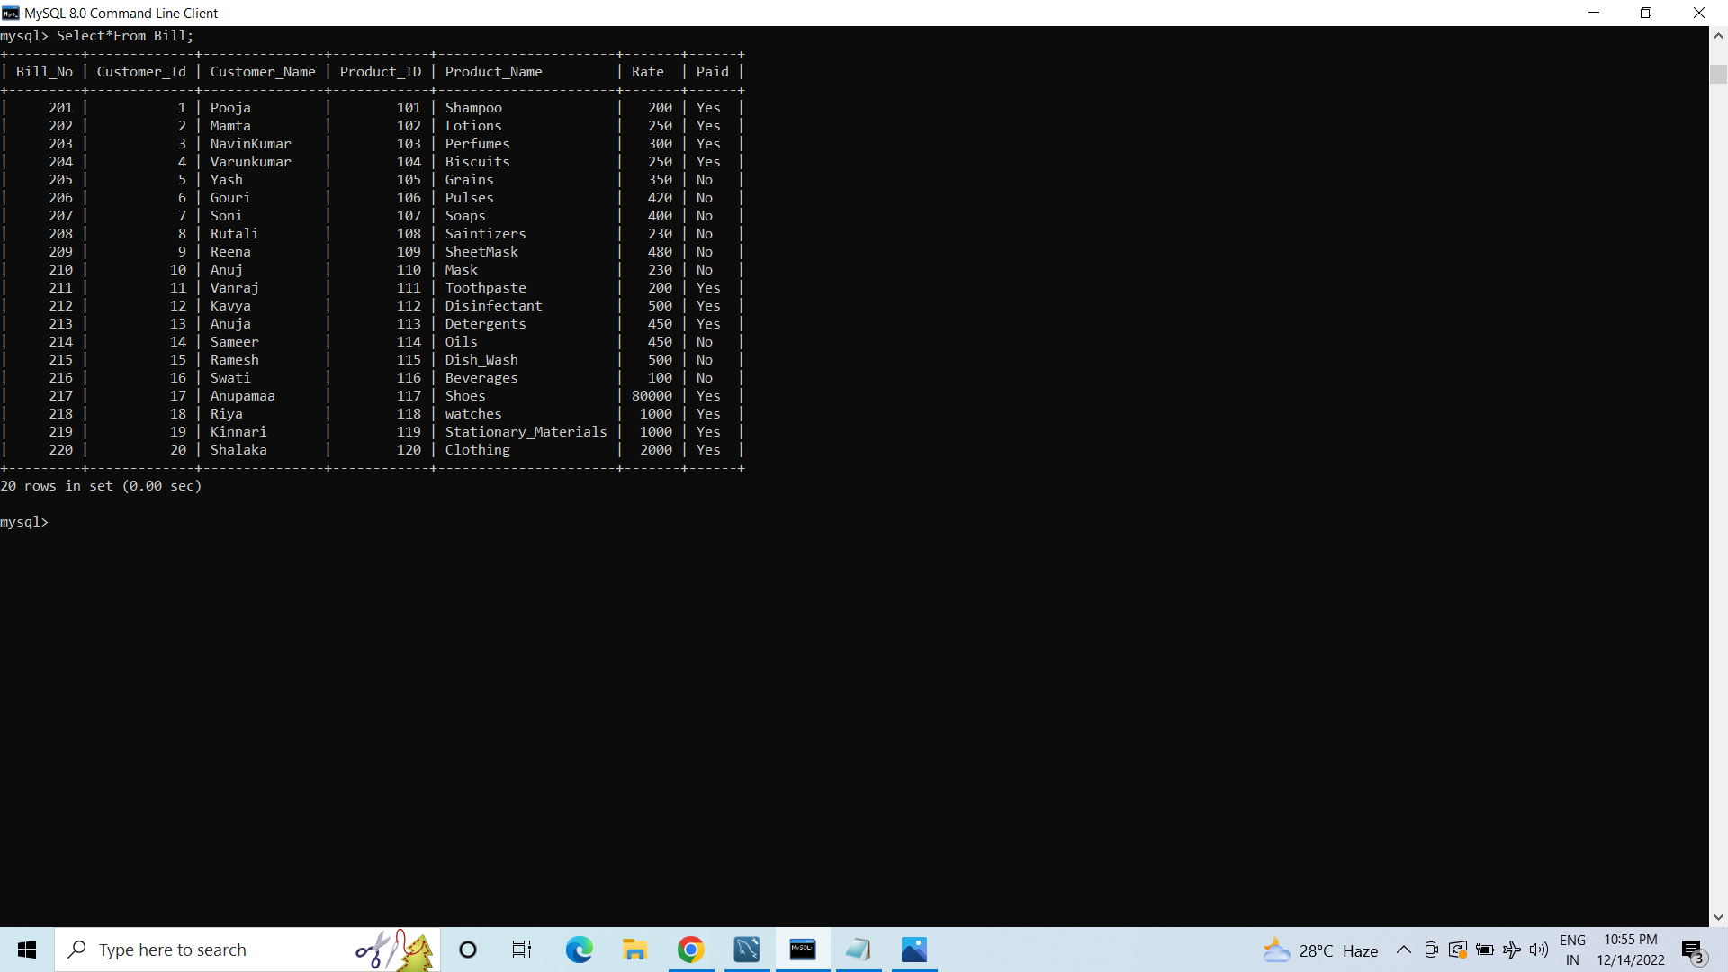
To Read the Data from the Table.

Slide 15
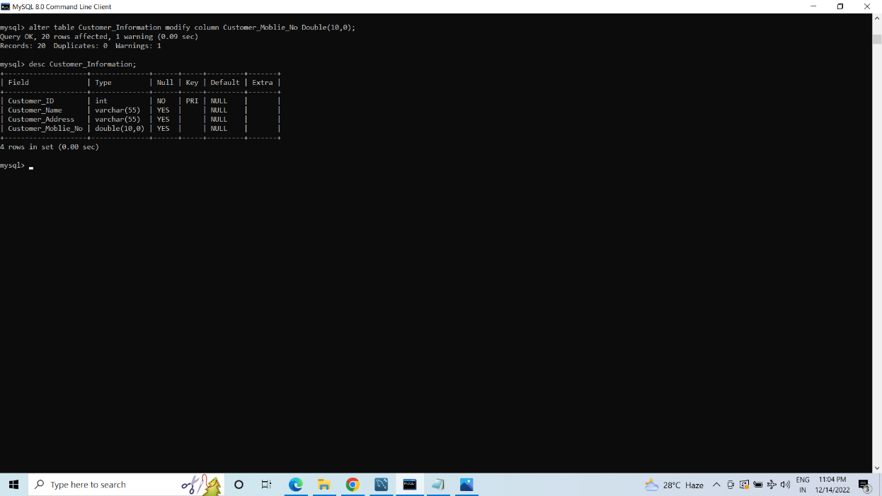
Alter & Update Commands.

Slide 16
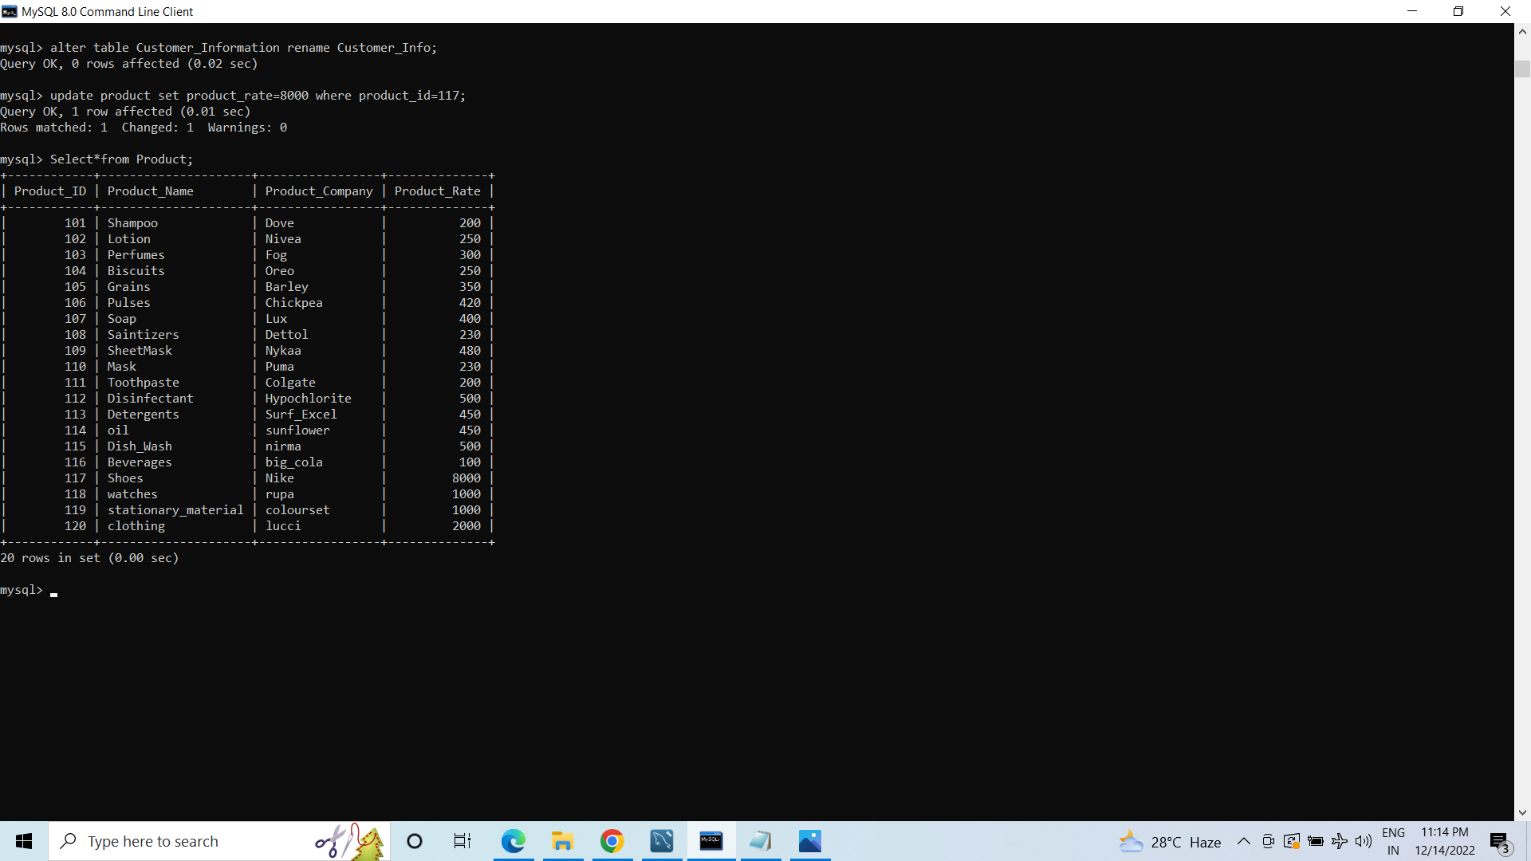
Alter & Update Commands.

Slide 17
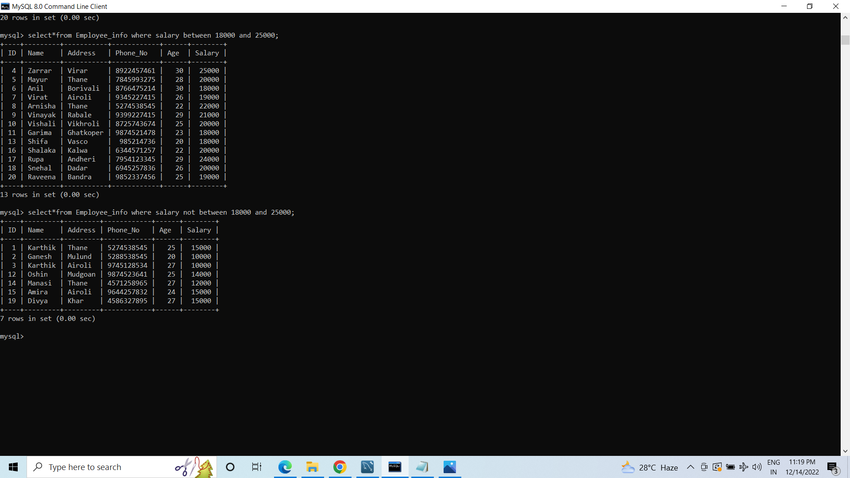
Using Where Clause with Between & Not Between Operator.

Slide 18
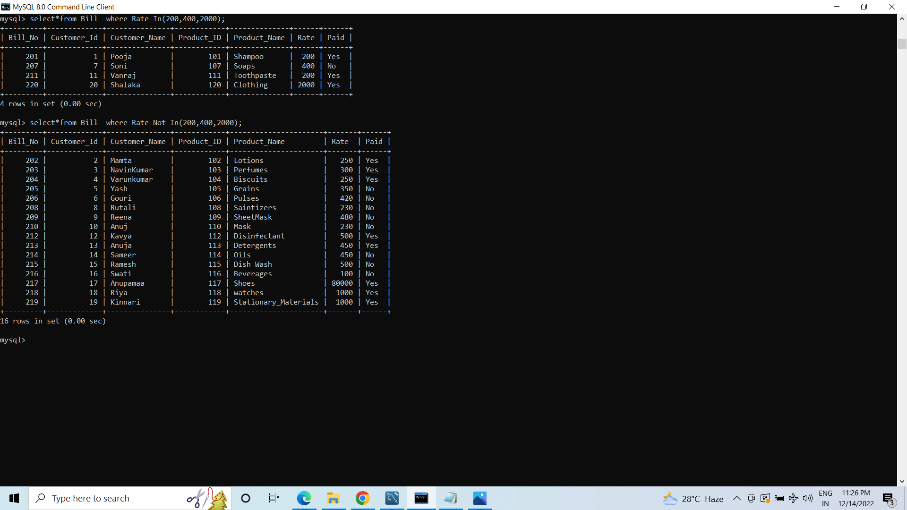
Using Where Clause with In & Not In Operator.

Slide 19
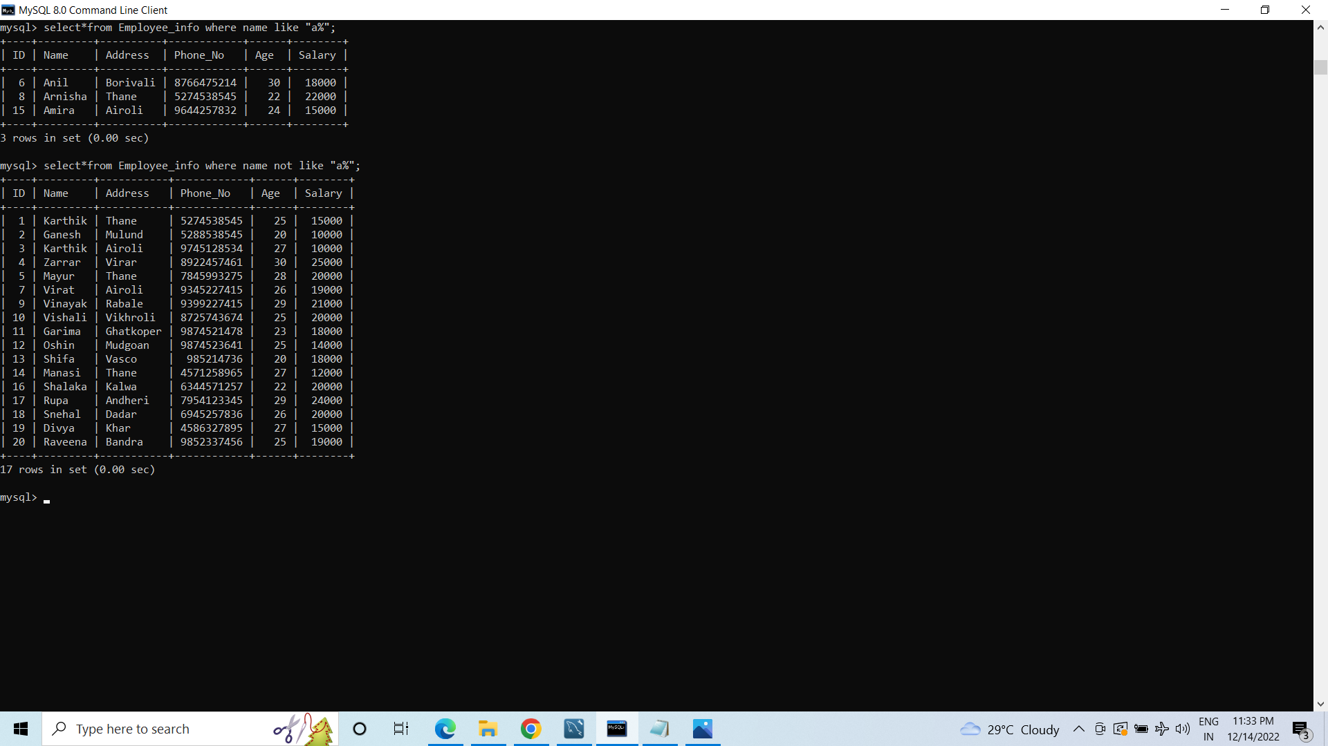
Using Where Clause with Like & Not Like Operator.

Slide 20
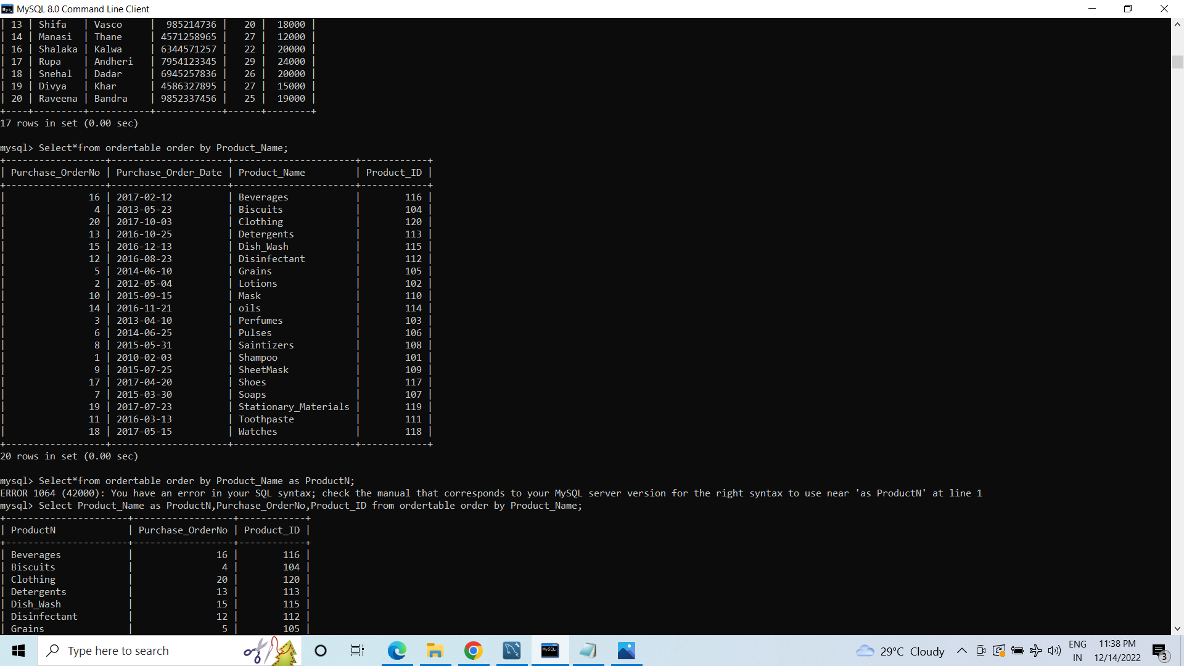
Sorting the Data.

Slide 21
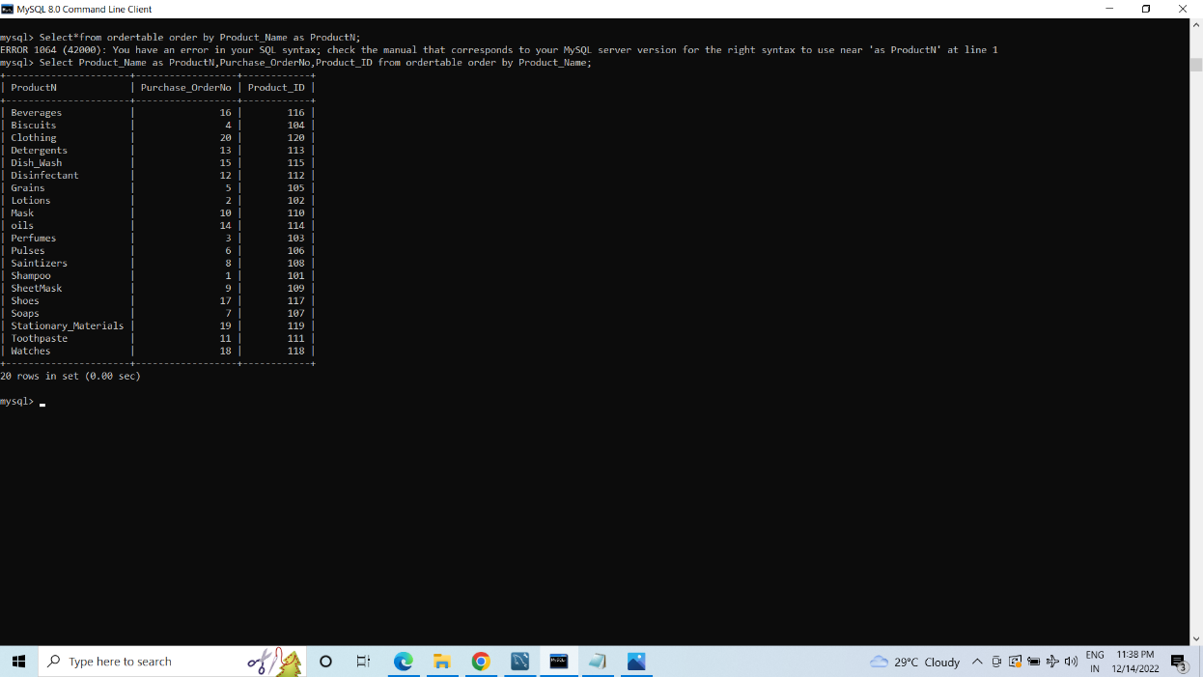
Sorting the Data.

Slide 22
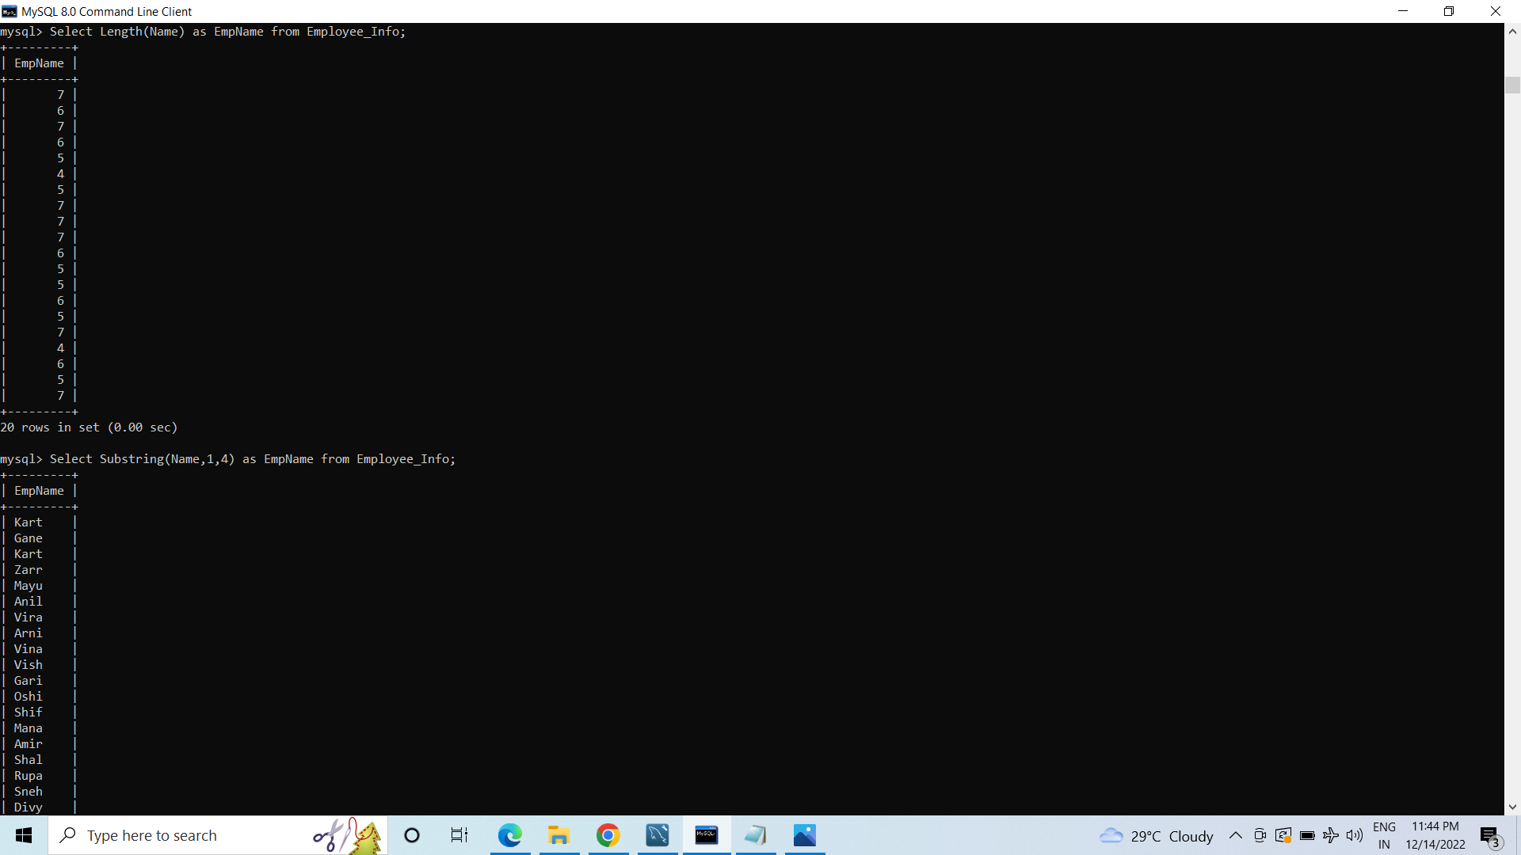
Using String() Functions.

Slide 23
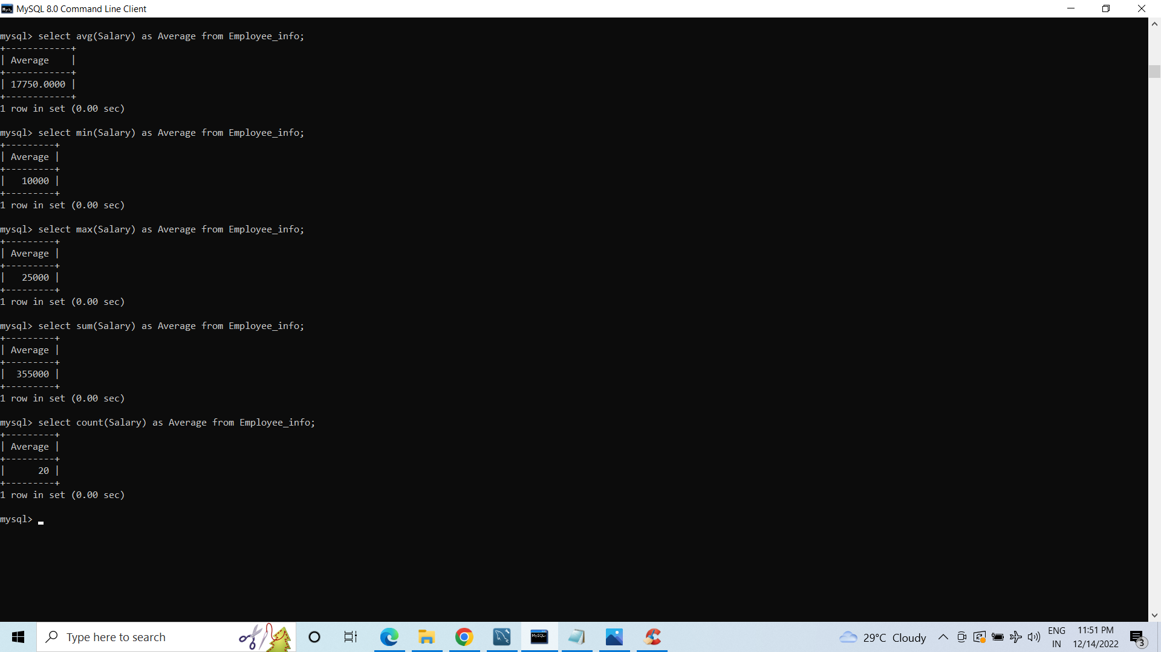
Using Aggregate() Functions.

Slide 24
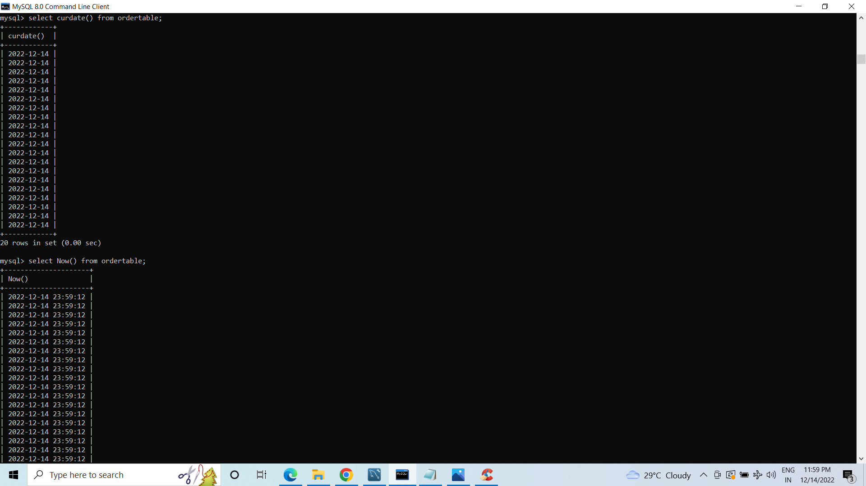
Using Date() Functions.

Slide 25
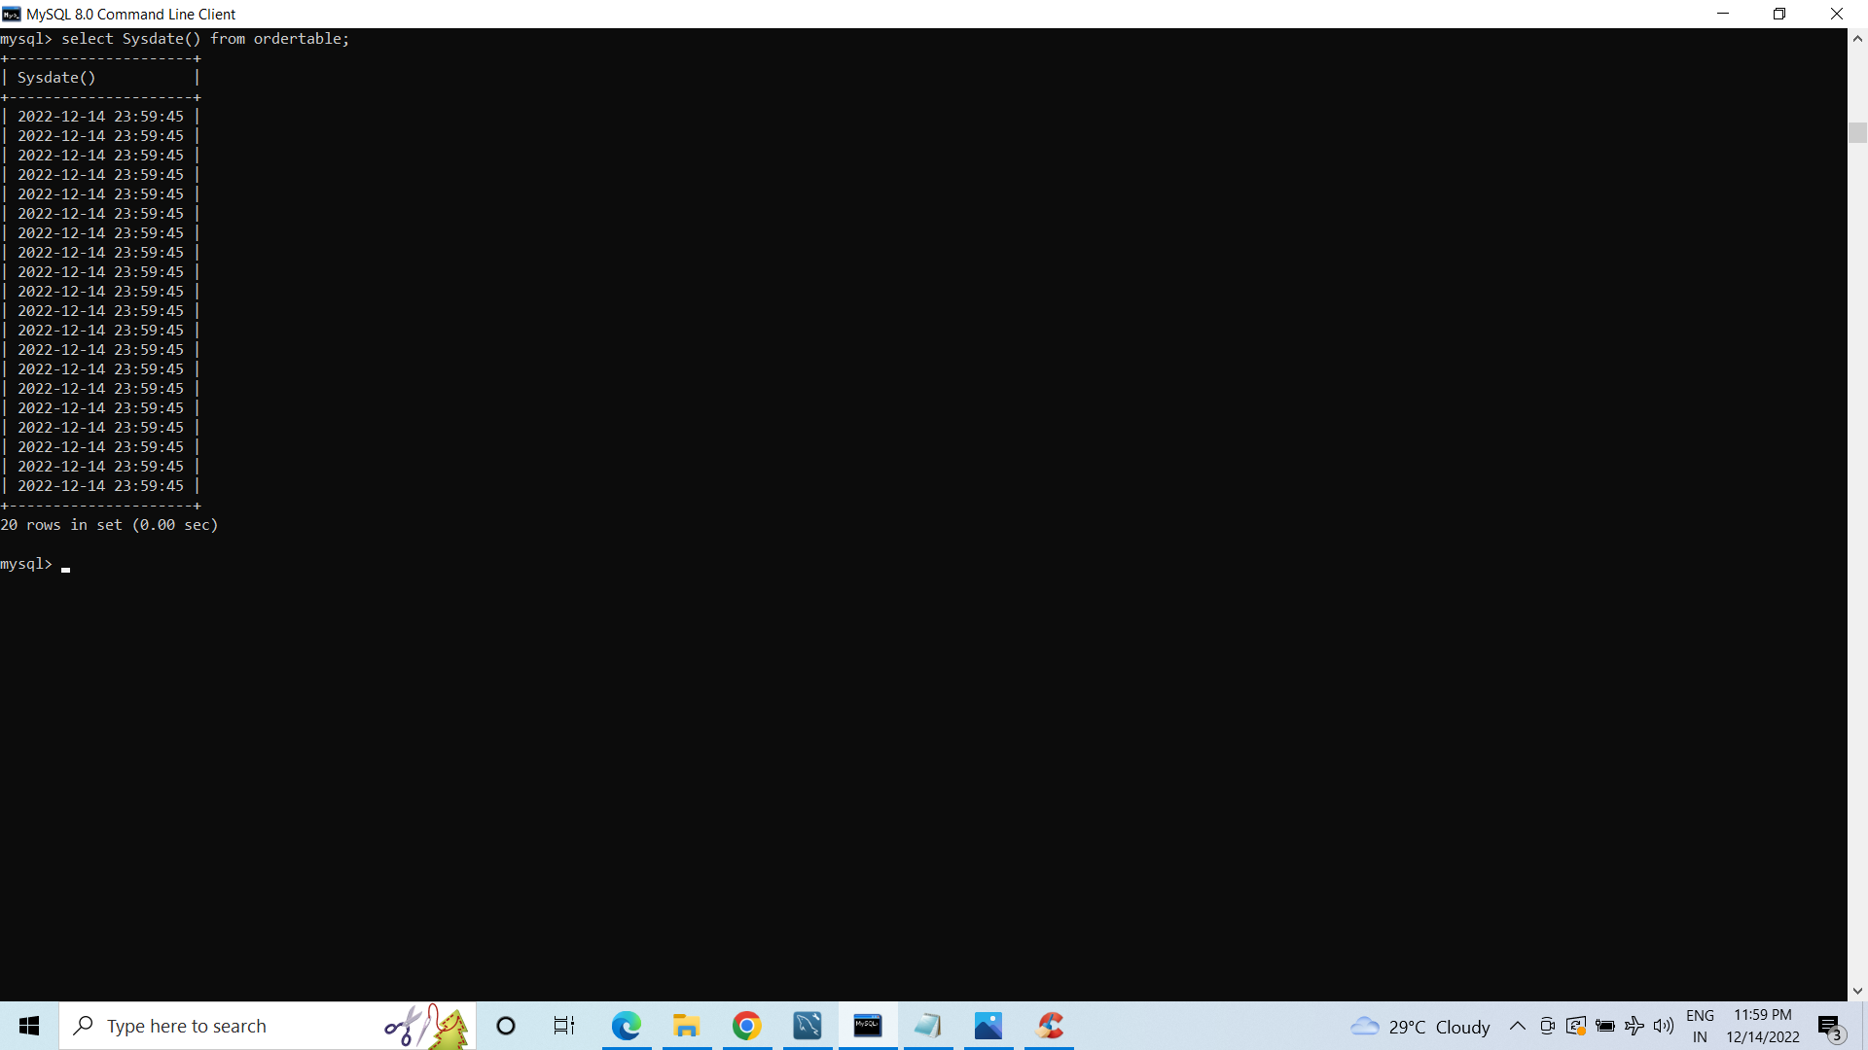
Using Date() Functions.

Slide 26
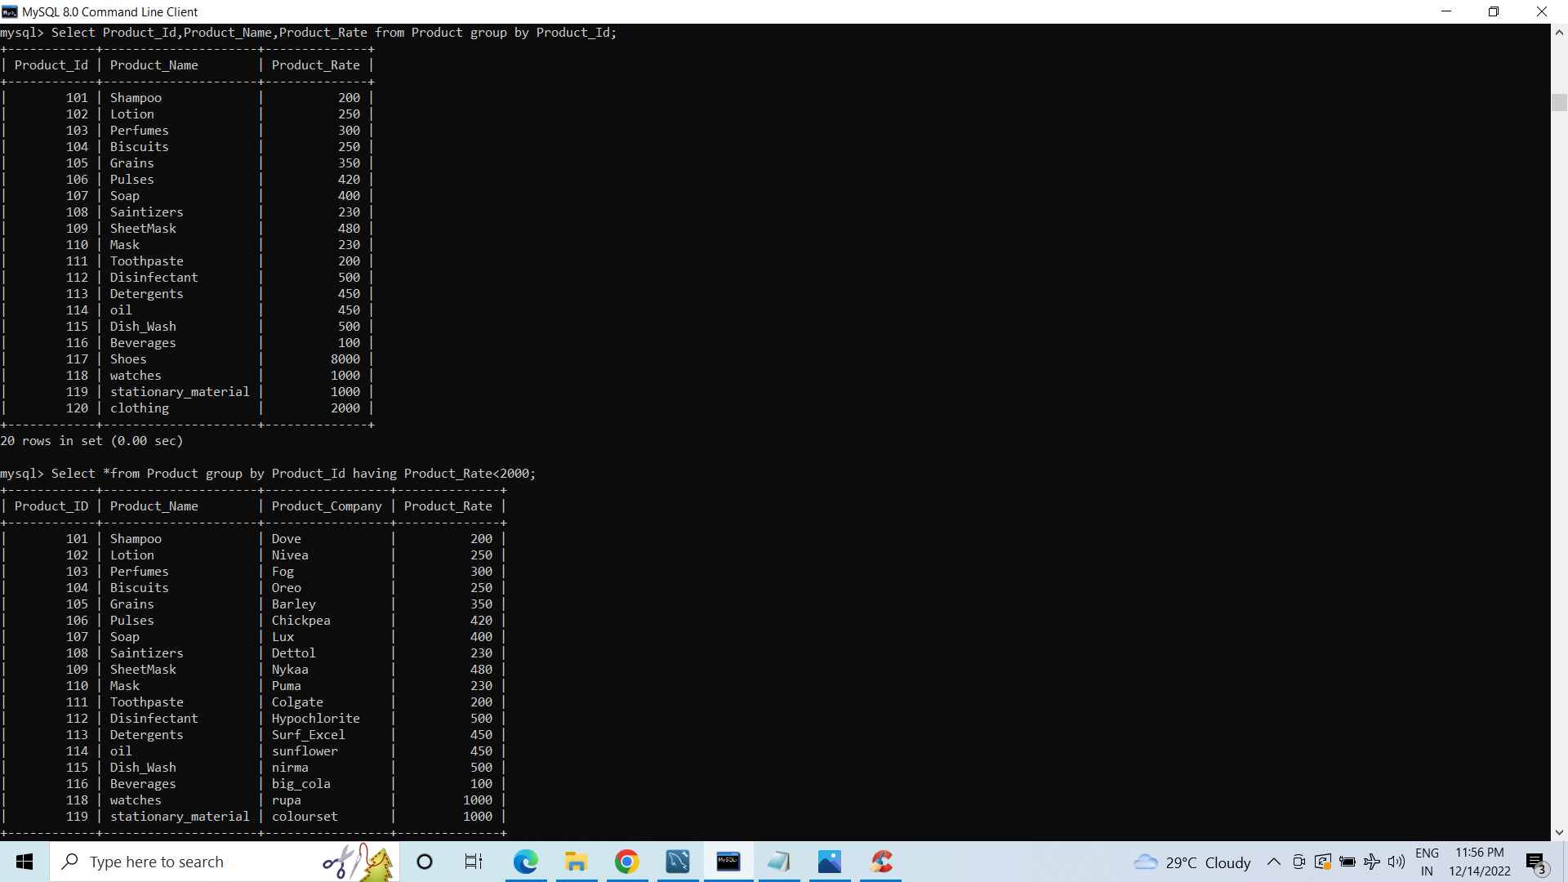
Using Group By & Having Clause.

Slide 27
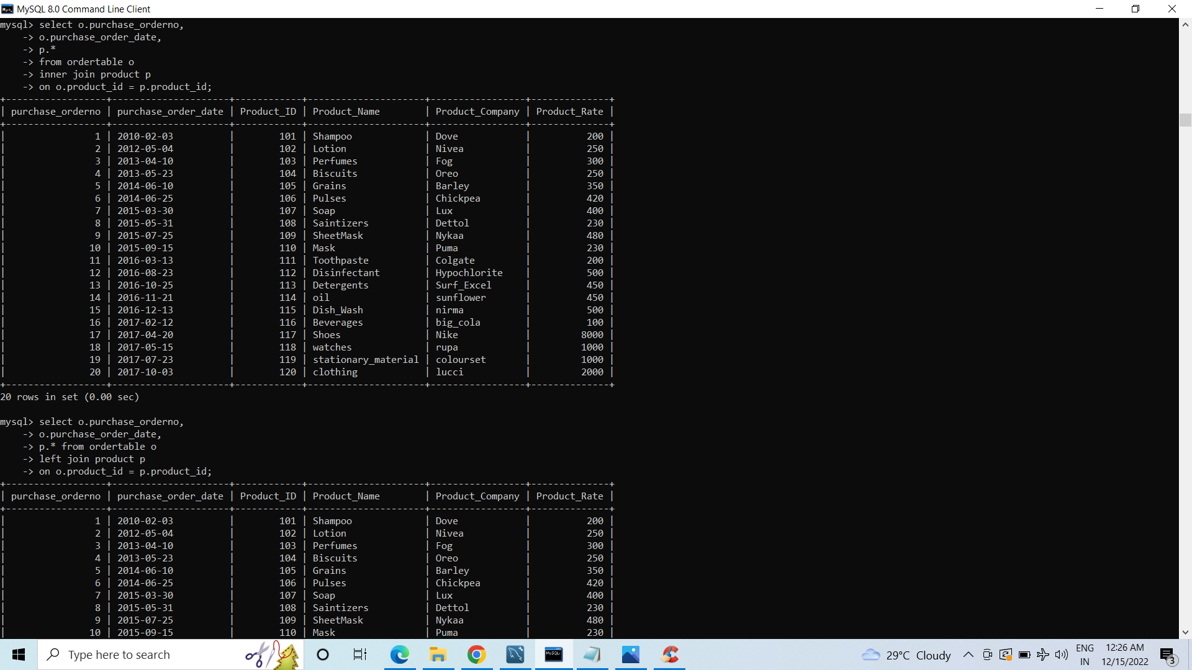
Using Join.
Inner Join.

Slide 28
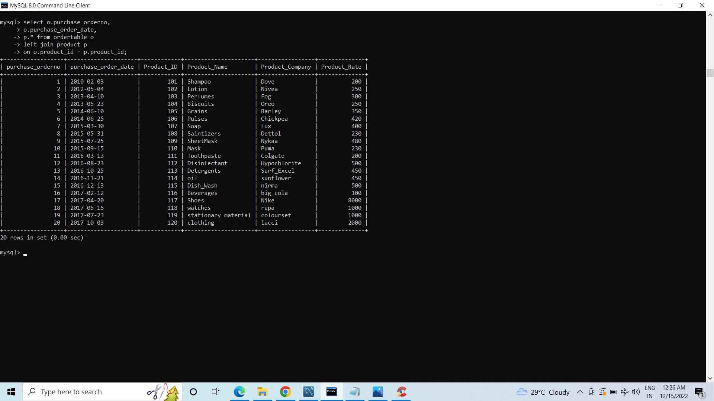
Using Join.
Left Join.

Slide 29

Using Join.
Right Join.

Slide 30
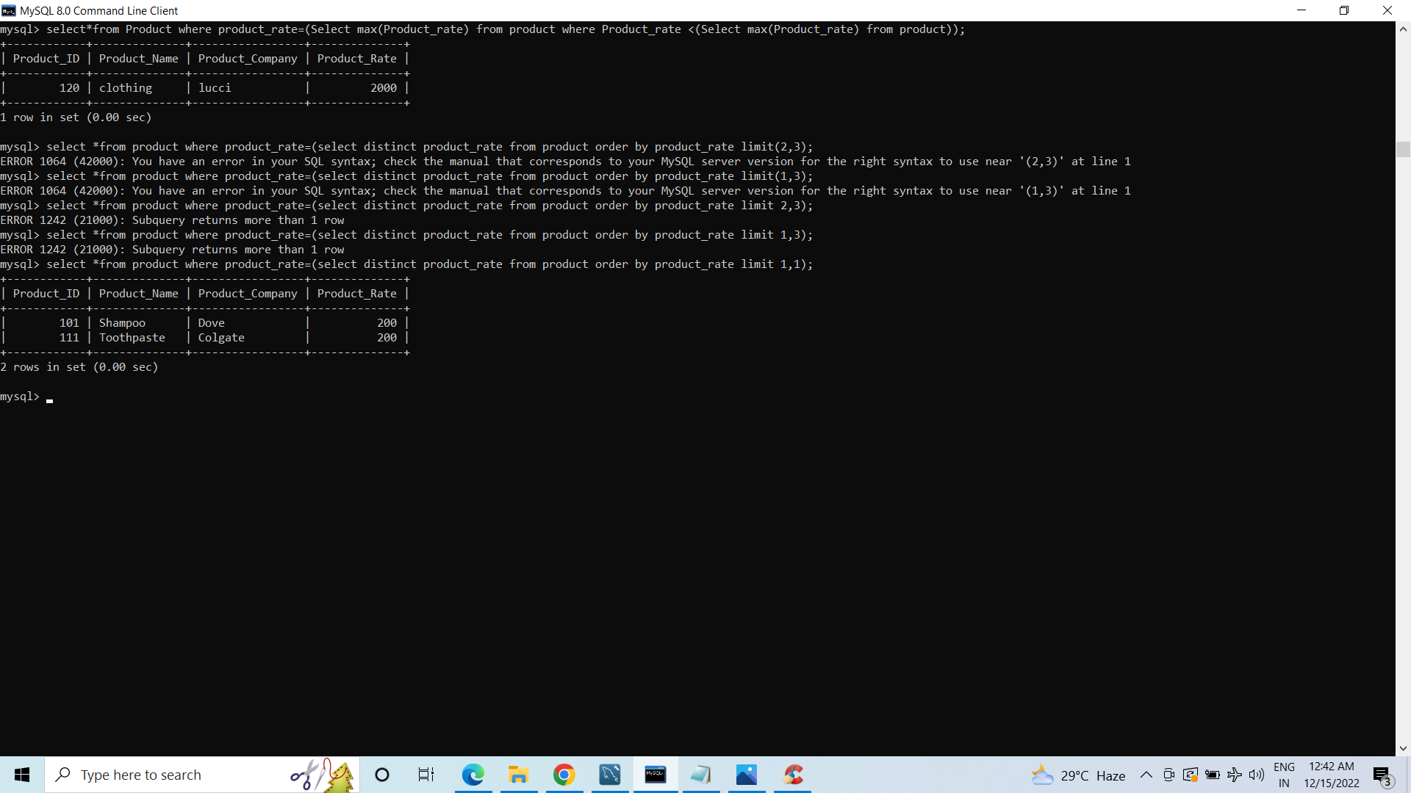
Using Subqeries.

Slide 31
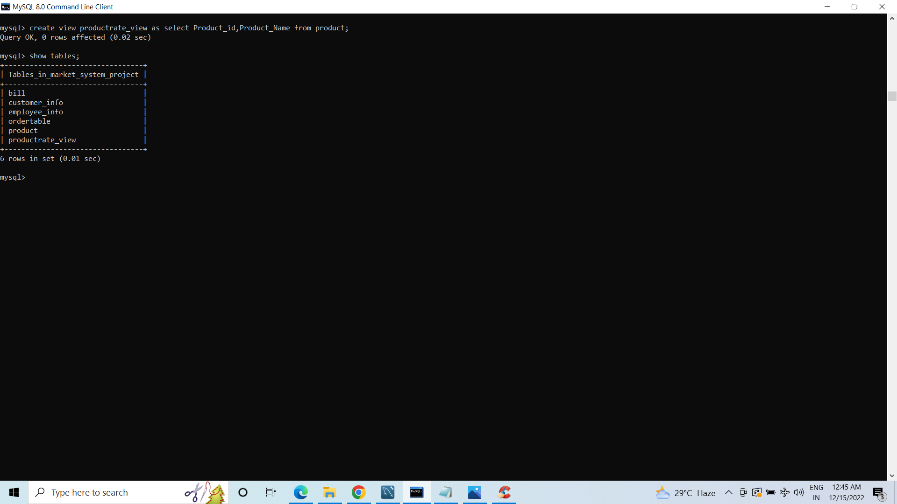
Using View.

